Slide 1
SHRTS (URL SHORTENER)
Bachelor of Engineering in
Computer Science & Engineering
(Session 2020-2021)
Guided By: Submitted By:
Mrs. Kavita Chourasia -> Shoaib Ahmed (188230133)
-> Subhang Pati (188230144)
-> Aman Shrivastava (188230016)
-> Shailesh Gotiya (188230128)
-> Ishu Kumar Verma (188230040)

Slide 2
CONTENTS
Introduction
Literature Survey
Problem Definition
Methodology & Tools
Expected Output
References

Slide 3
INTRODUCTION
URL shortening is a technique on World Wide Web in which a Uniform Resource Locator (URL) may be made substantially shorter and still direct to the required page.
For example, the URL “ https://example.com/assets/category_B/subcategory_C/Foo/ “ can be shortened to https://example.com/Foo .
Short URLs reduces the amount of typing required if the reader is copying a URL from a print source, for making it easier for a person to remember, or for the intention of a permalink.
Some URL shortening service providers have found themselves on spam blacklists, because of the use of their redirect services by sites trying to bypass those very same blacklists.
Short URLs may be more convenient for websites or hard copy publications (e.g. a printed magazine or a book).

Slide 4
Literature Survey
The idea behind URL shortening services is to assist in the easy sharing of URLs by providing a short equivalent. The user can then publish the short URL on any webpage, blog, forum or OSN, exactly as she would use the original URL.
URL shortening services have existed at least as early as 2001 , tinyURL is probably the first such, well-known, service.
As a consequence, dozens of such services exist today, although only a handful of them, such as bit.ly, ow.ly and tinyURL, capture the lion’s share of the market.
Besides providing a short URL for each long one, some of these services provide statistics about the accesses of these URLs.

Slide 5
The previously discussed collection process resulted in following datasets:
twitter : The trace contains 887,395 unique bit.ly short URLs posted on Twitter between the 22nd of April and the 3rd of May 2010. For each short URL, all the accompanied metadata are also collected.
owly : This trace contains 674,239 ow.ly short URLs created between the 26th of April and the 3rd of May 2010. As described in the brute-force methodology, this constitutes the entire population of ow.ly short URLs created in that period.
bitly : Contains 171,044 unique bit.ly short URLs collected by exhaustively searching the available key space for hash sizes of 1 to 3 characters. All the accompanied metadata for each short URL are also collected.

Slide 6
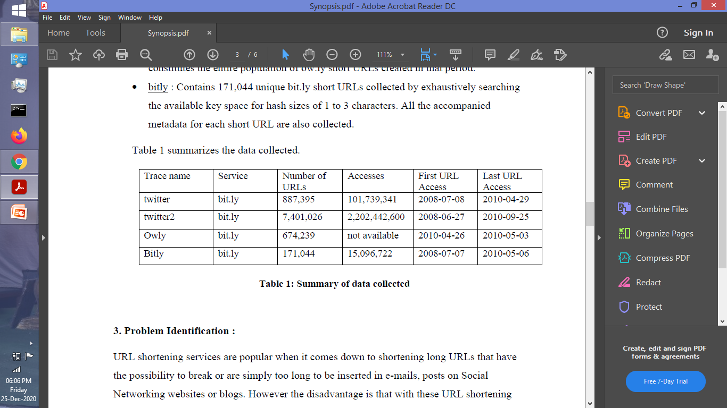

Slide 7
Problem Definition
URL shortening services are popular when it comes down to shortening long URLs that have the possibility to break or are simply too long to be inserted in e-mails, posts on Social Networking websites or blogs.
Avoid Long URL Sharing:-
If anyone wanted to share an URL via article, e-mail, or any other medium then it is not a good idea to put long link there because they are too messy and difficult to manage.
Example :-
What is easier to share:
This- “ http://friendfeed.com/e/b17ab777-ceb6-f7fd-841-ca3a6ca9c9d4/Flutter-Mocks-You-Me-and-Our-Microblogging/ ”
or this – “ https://shrts.herokuapp.com/uzMIwf31i ”
To avoid for such problem, the generation of a short URL will be helpful as it takes less space, easy to manage and to write on search bar and attracts the reader.

Slide 8
Typing URL :-
It will be difficult for a person to take URL input from a printed source (like magazines, newspaper, poster) even after it has been shorted.
If there is any kind of mistake (even of single character) while typing the URL in search bar, the this will take user to another page, may show error 404.
To avoid for such problem, the generation of a QR code for URL will be helpful as by scanning it, the user can be taken to the desired web page.

Slide 9
Methodology & Tools
Our URL shortener system should meet the following requirements:
Function Requirement:
1. Given a URL, our service should generate a shorter and unique alias of it.
2. When users access a shorter URL, our service should redirect them to the original link
3. Users should optionally be able to pick a custom alias for their URL.
4. Links will expire after a specific timespan automatically, users should also be able to specify expiration time.
Non-Function Requirement:
1. The system should be highly available. This is required because if our service is down, all the URL redirections will start failing.
2. URL redirection should happen in real-time with minimum latency.
3. Shortened links should not be guessable (not predictable).

Slide 10
npm Packages We Are Going To Use:
config :
It lets you define a set of default parameters, and extend them for different deployment environments (development, QA, staging, production, etc.). For production, we have to define production.js similarly for development devlopment.js. By default, it will look for default.js.
This will be used to store config related to DB and others.
valid-url:
This module collects common URI validation routines to make input validation, and maintaining easier and more readable. All functions return an untainted value if t he test passes, and undefined if it fails.
This will be used to validate the URL given by the user for a shortening purpose.
shortid:
ShortId creates amazingly short non-sequential URL-friendly unique ids.
This will be used to generate a unique id for each shortened URL.

Slide 11
express:
The Express philosophy is to provide small, robust tooling for HTTP servers, making it a great solution for single-page applications, web sites, hybrids, or public HTTP APIs.
This will be used to create the server and route different HTTP path.
mongoose:
Mongoose is a MongoDB object modeling tool designed to work in an asynchronous environment. Mongoose supports both promises and callbacks. As they use promise we will use async and await feature of JS.
This will be used for connecting with MongoDB, saving, updating and querying the DB.

Slide 12
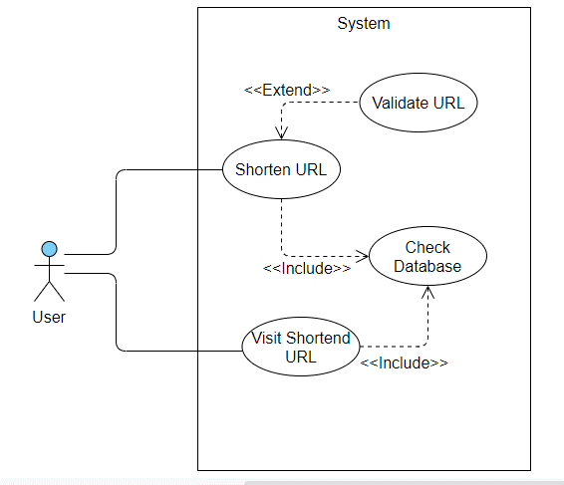
Usecase Diagram:-

Slide 13
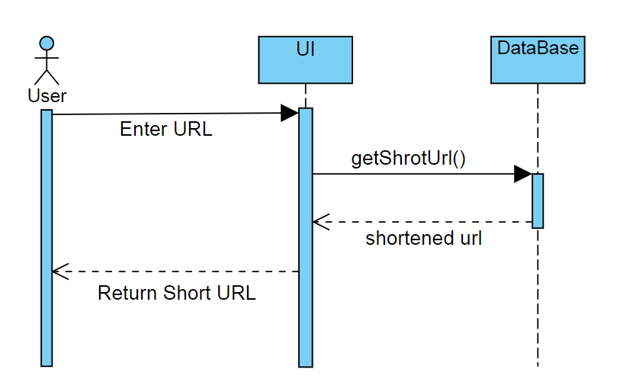
Sequence Diagram For URL Shortening:-
Browser
Server

Slide 14
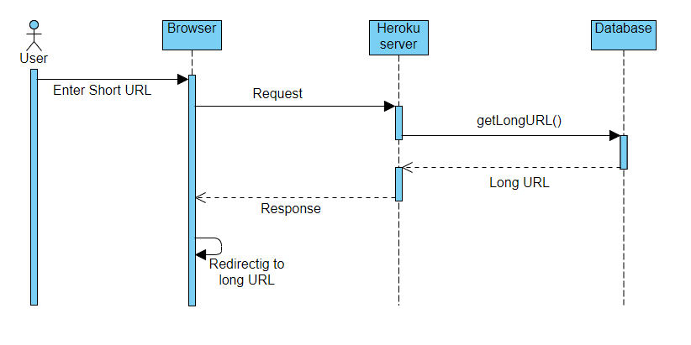
Sequence Diagram For Visiting Shortened URL:-

Slide 15
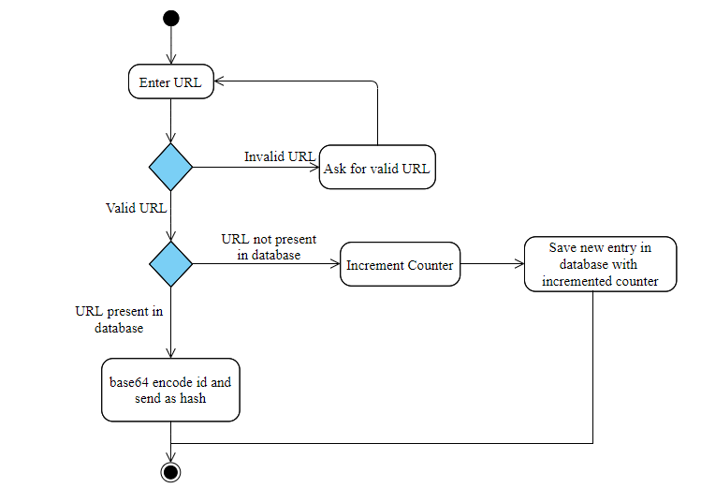
Activity Diagram For URL Shortening:-

Slide 16
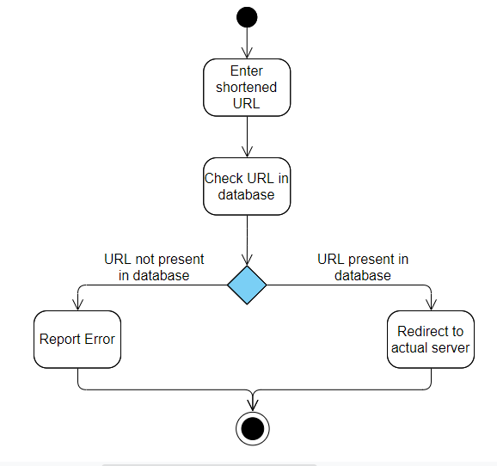
Activity Diagram For Visiting Shortened URL:-

Slide 17
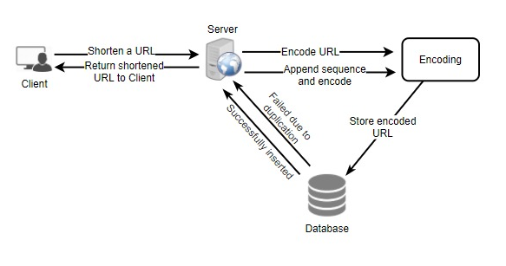
Flow Diagram for shortening URL:-

Slide 18
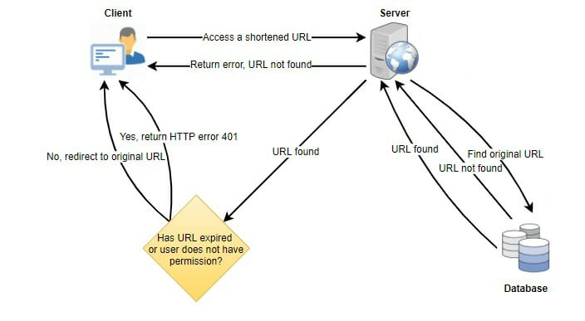
Flow Diagram for visiting shortened URL:-

Slide 19
Expected Outputs
User can able to enter long URL, and custom alias (which is optional).
First it will check if the Long URL is valid or not.
It will check if the custom alias exist already or not. If Yes, then it will show error. If No, then it will store the long url, and short Code into database, and send short URL to user as a result.
If user doesn’t enter custom alias then it will generate a unique shortId, and then create the short URL.
It will also generate the QR corresponding to URL.
The Generated short URL will automatically deleted from database after 6 months of last access.

Slide 20
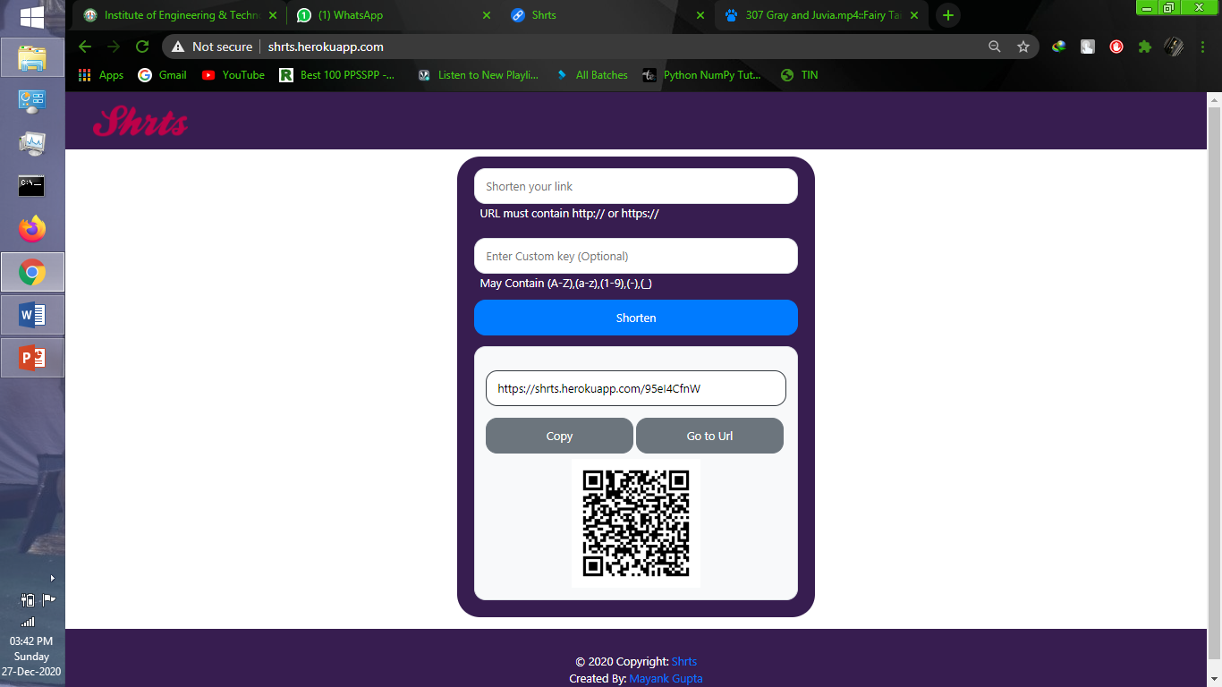
Example:-
“ https://www.cartoonsarea.xyz/Japanese-Dubbed-Videos/F-Subbed-Series/Fairy-Tail-Final-Subbed-Videos/Fairy-Tail-Final-Season-9-Subbed-Videos/Fairy-Tail-Final-Episode-30-Subbed-Videos/307%20Gray%20and%20Juvia.mp4.php ”
can be shortened as :-
“ https://shrts.herokuapp.com/95eI4CfnW ”
with equivalent QR Code :-

Slide 21
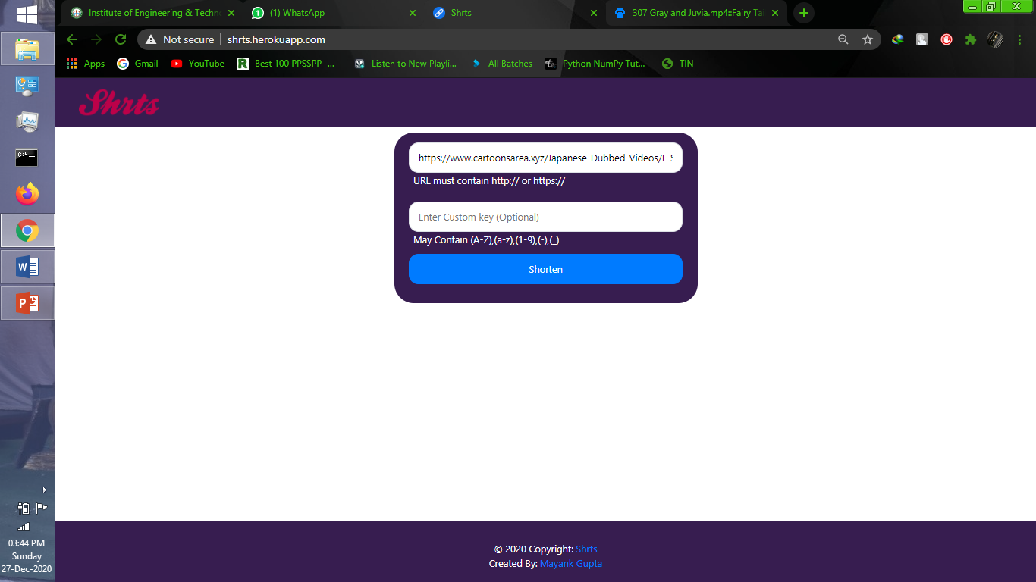

Slide 23
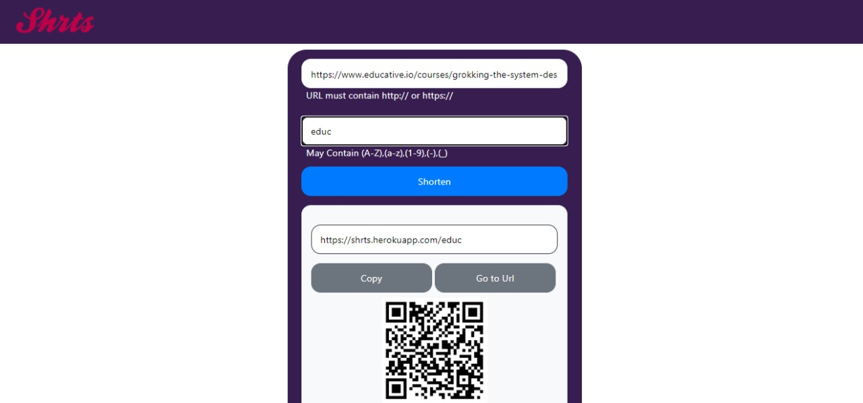

Slide 24
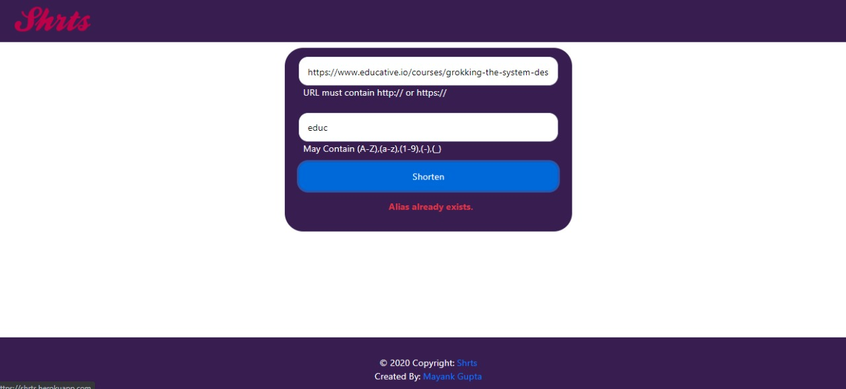

Slide 25
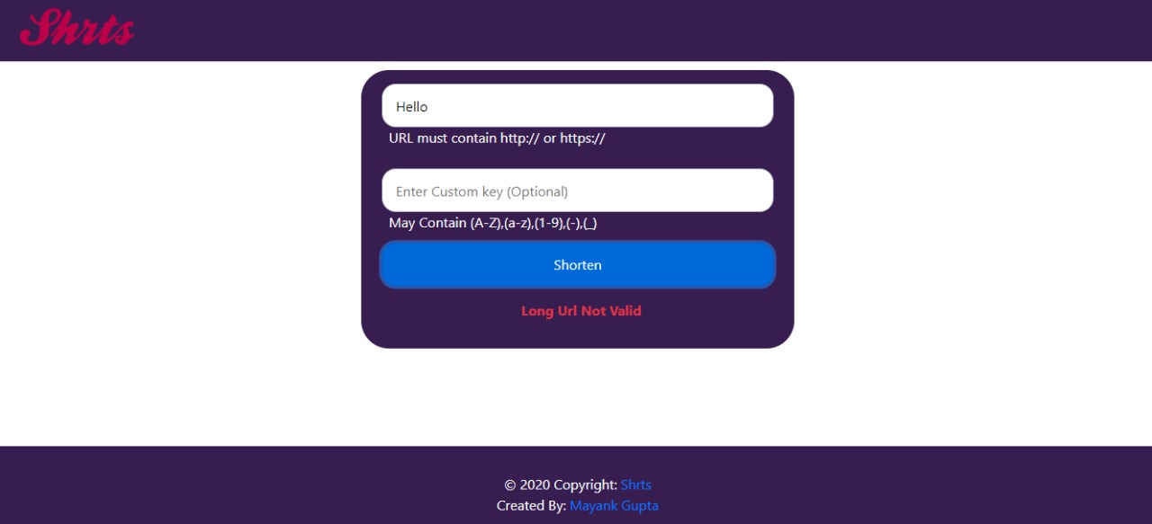

Slide 26
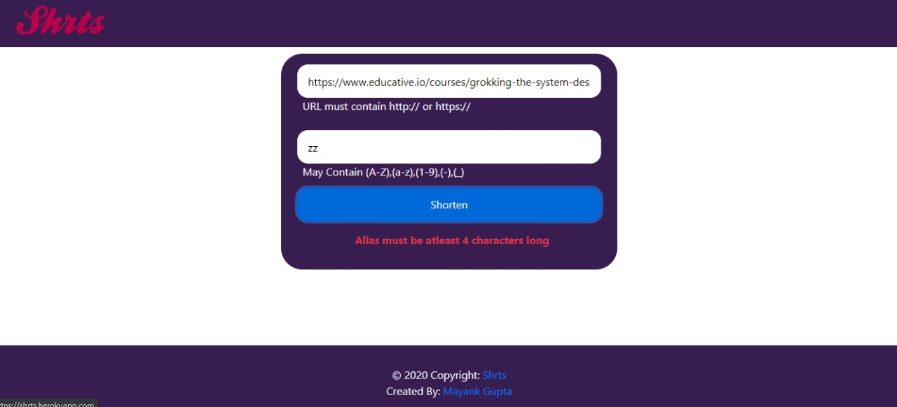

Slide 27
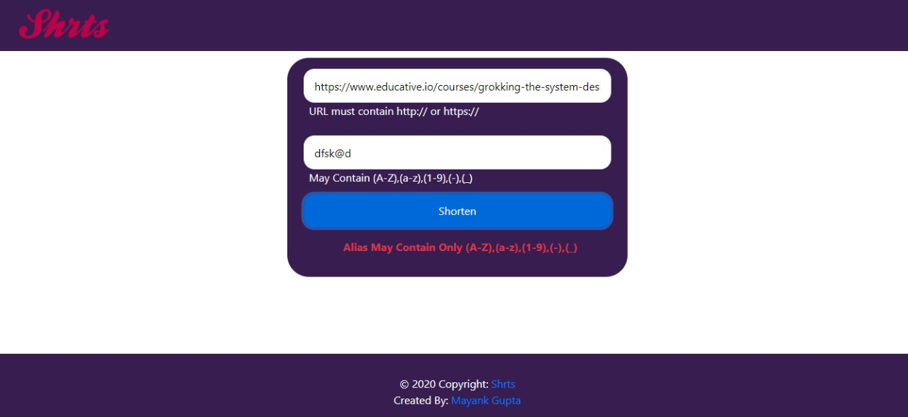

Slide 28
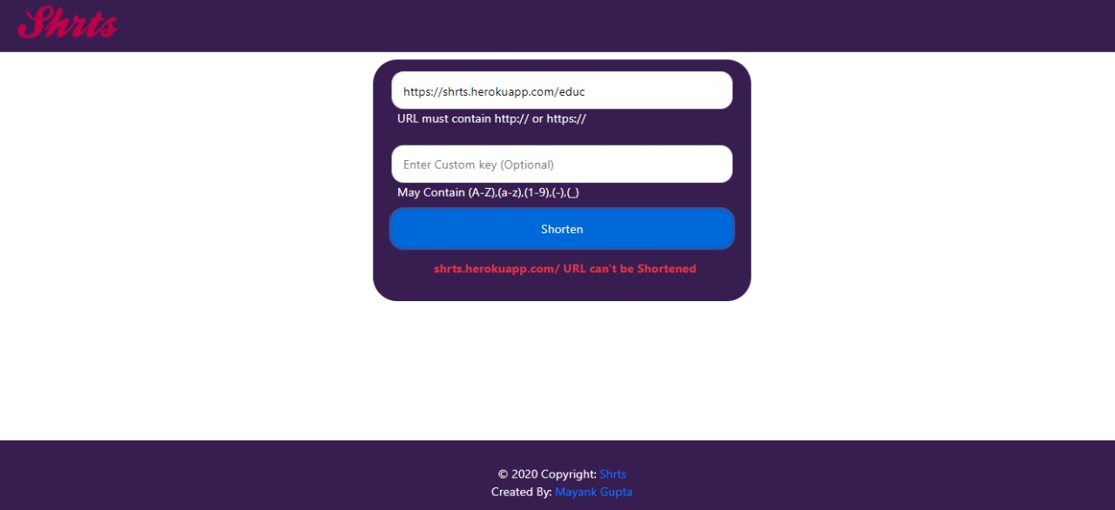

Slide 29
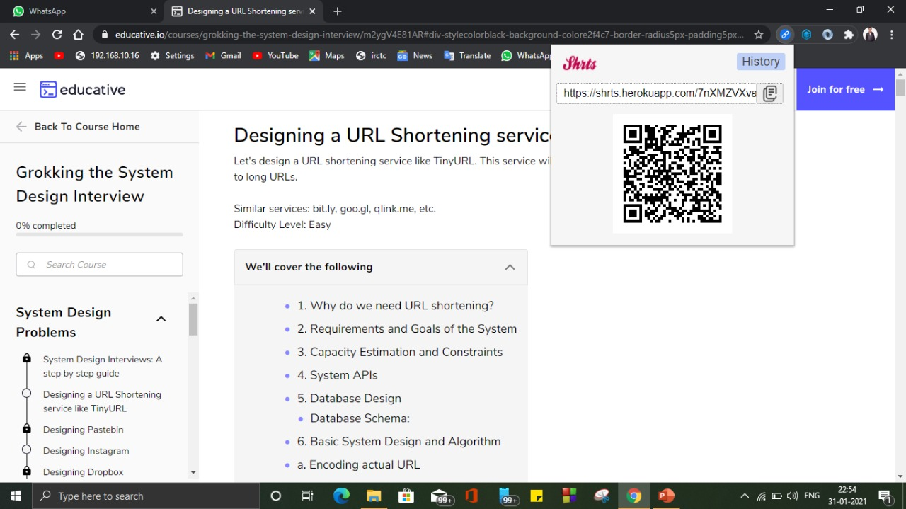

Slide 30
References:
https://en.wikipedia.org/wiki/URL_shortening , URL Shortening
https://medium.com/javascript-in-plain-english/creating-a-url-shortener-with-node-js-and-mongodb-db4bc6488445, Creating a URL shortener with Node.js and MongoDB.
TinyURL.com. http://tinyurl.com/
Bitly https://bit.ly/

